Slide 1
City Hunter
CREATED BY CINDY WIJAYA

Slide 2
Introduction
City hunter is a mini game created by Adobe Flash.
In this game, the plane has to win the war by protecting the city from the hunters.

Slide 3
Rule
The plane has 3 life. Once the hunters shoot it , its life will be lose. However, if the plane successfully shoots the hunter, the score will be added. The plane can go to left , right , up , and down. The plane will be able to shoot the hunters by pressing space on the keyboard.

Slide 4
Purpose
The purpose of this game is to entertain the hildern by deligthing the animation and reducing the gun speed.

Slide 5
Page
There are 4 scenes in this game:
-Home scene
-Menu scene
-How to play scene
-Play scene
-Credit scene

Slide 6

Home scene
In this scene, the animations and the picturec will be loaded. It will take several seconds to move to the next scene.

Slide 7




Menu scene
Menu scene will appear after the home scene loaded. This scene provides 3 options menu.

Slide 8
How to play scene

Slide 9
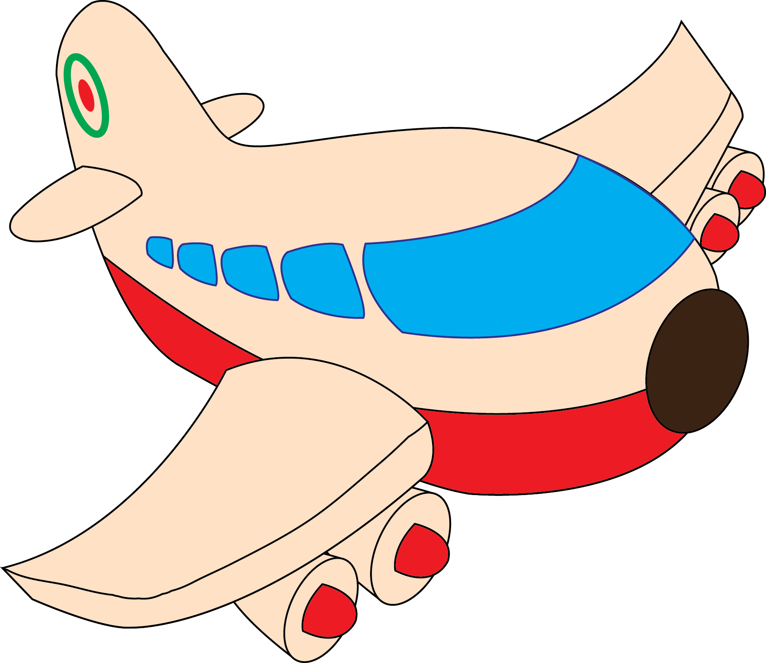

Start game scene

Slide 10
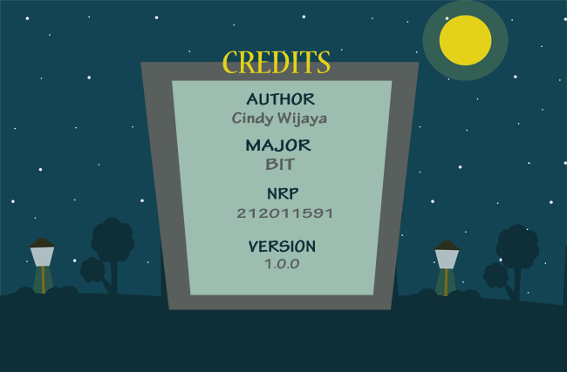
Credit scene
This scene shows the detail of the game.

Slide 11
The End

